Slide 1
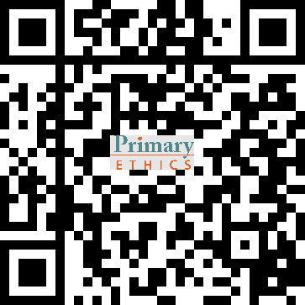
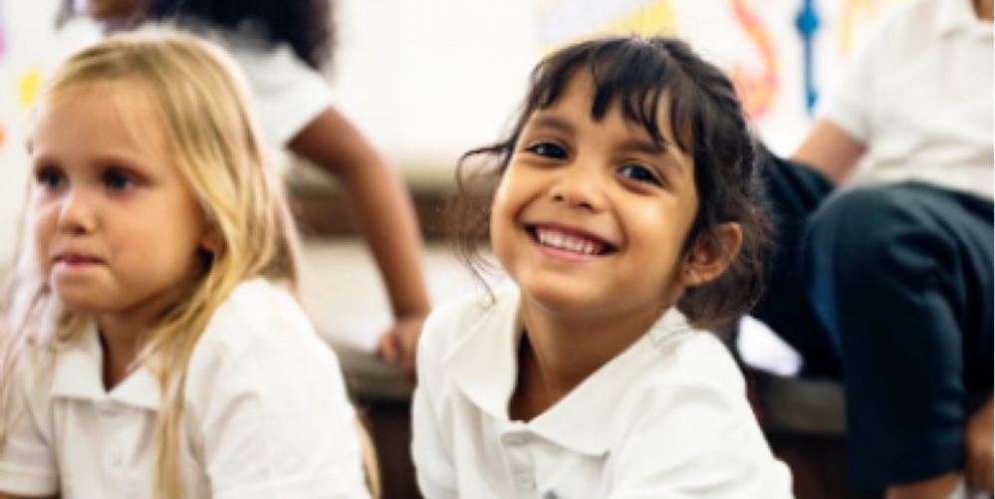
Ethics
Explore everyday ethical issues in the SRE/SEE timeslot
Topics for Kindergarten include:
What’s the fairest way to share something?
If you hurt someone without meaning to, should you get into trouble?
Is it ever okay to show off?
Ethics classes are run by parent and community volunteers.
To meet demand in 2024, we need more volunteers.
Great way to get involved and support your school
All lessons are fully scripted for you
Our volunteers come from all backgrounds and all ages – no teaching experience required
Full, free training provided, either online or in person
Half an hour each [insert day and time] in term time
Interested? Contact our ethics coordinator: [insert name and contact details]

