Slide 1


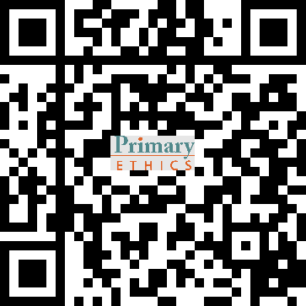
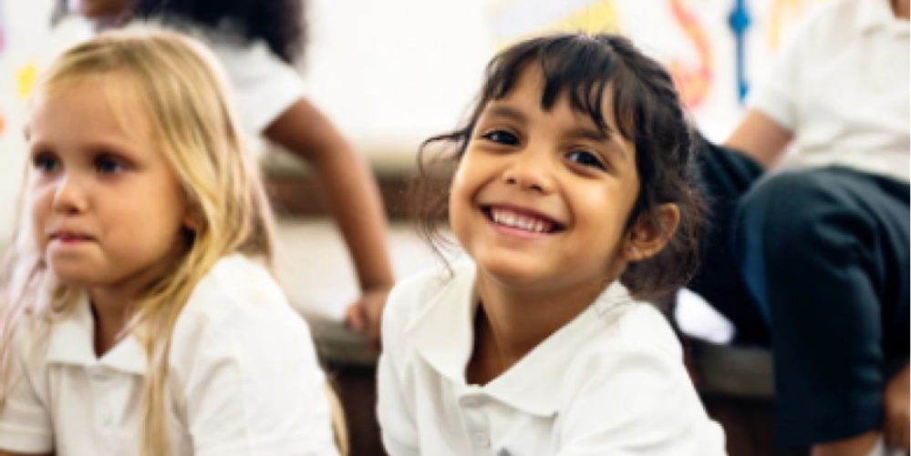
Ethics
      Explore everyday ethical issues with Kindy kids
      Topics for Kindergarten include:
    What’s the fairest way to share something?
    If you hurt someone without meaning to, should you get into trouble?
    Is it ever okay to show off?
      Ethics classes are run by parent and community volunteers.
      To meet demand in 2026, we need more volunteers.
    Great way to get involved and support your school
    All lessons are fully scripted for you
    Our volunteers come from all backgrounds and all ages – no teaching experience required
    Full, free training provided, either online or in person
    Lessons are for half an hour on X at X [insert day and time] in term time
Interested? Contact our ethics coordinator:
[insert name and contact details]
Find out more about ethics at an online info session: primaryethics.com.au/empowering-young-minds-webinars/

