Slide 1
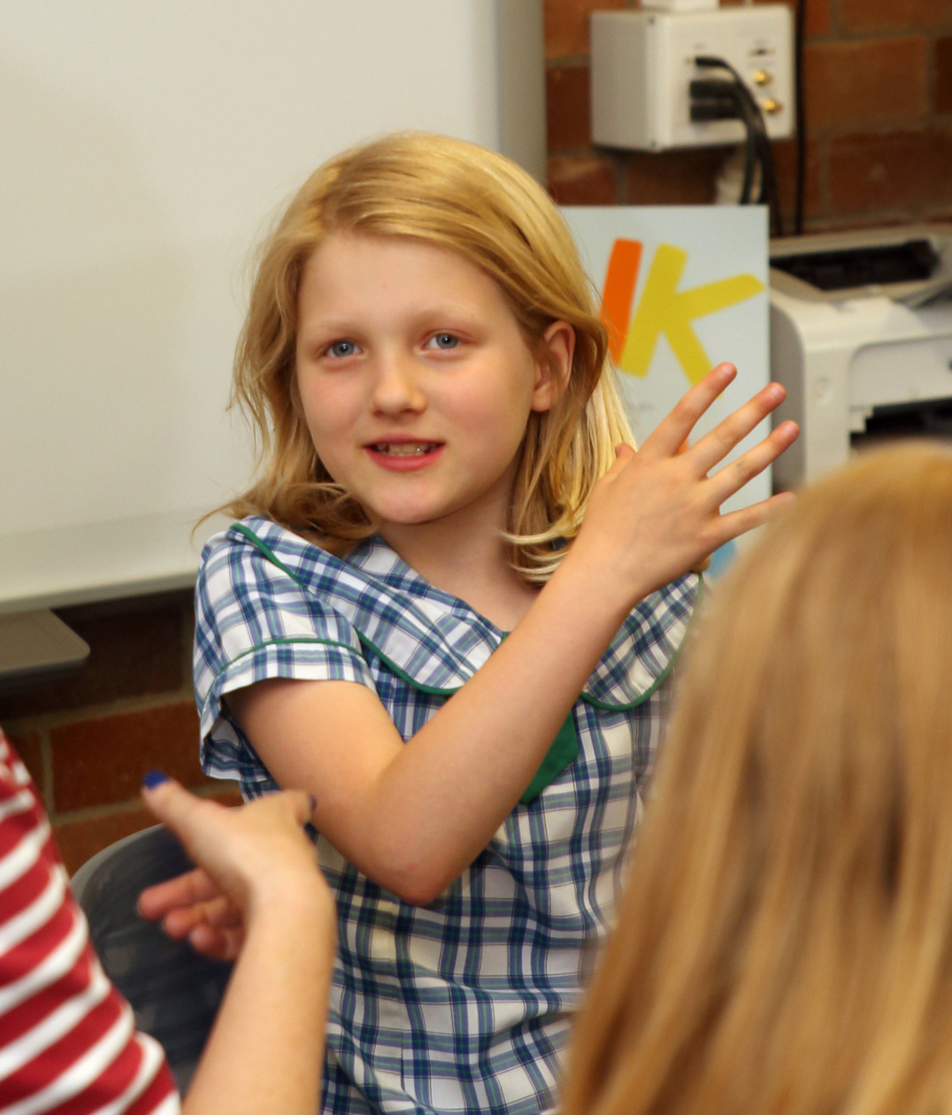

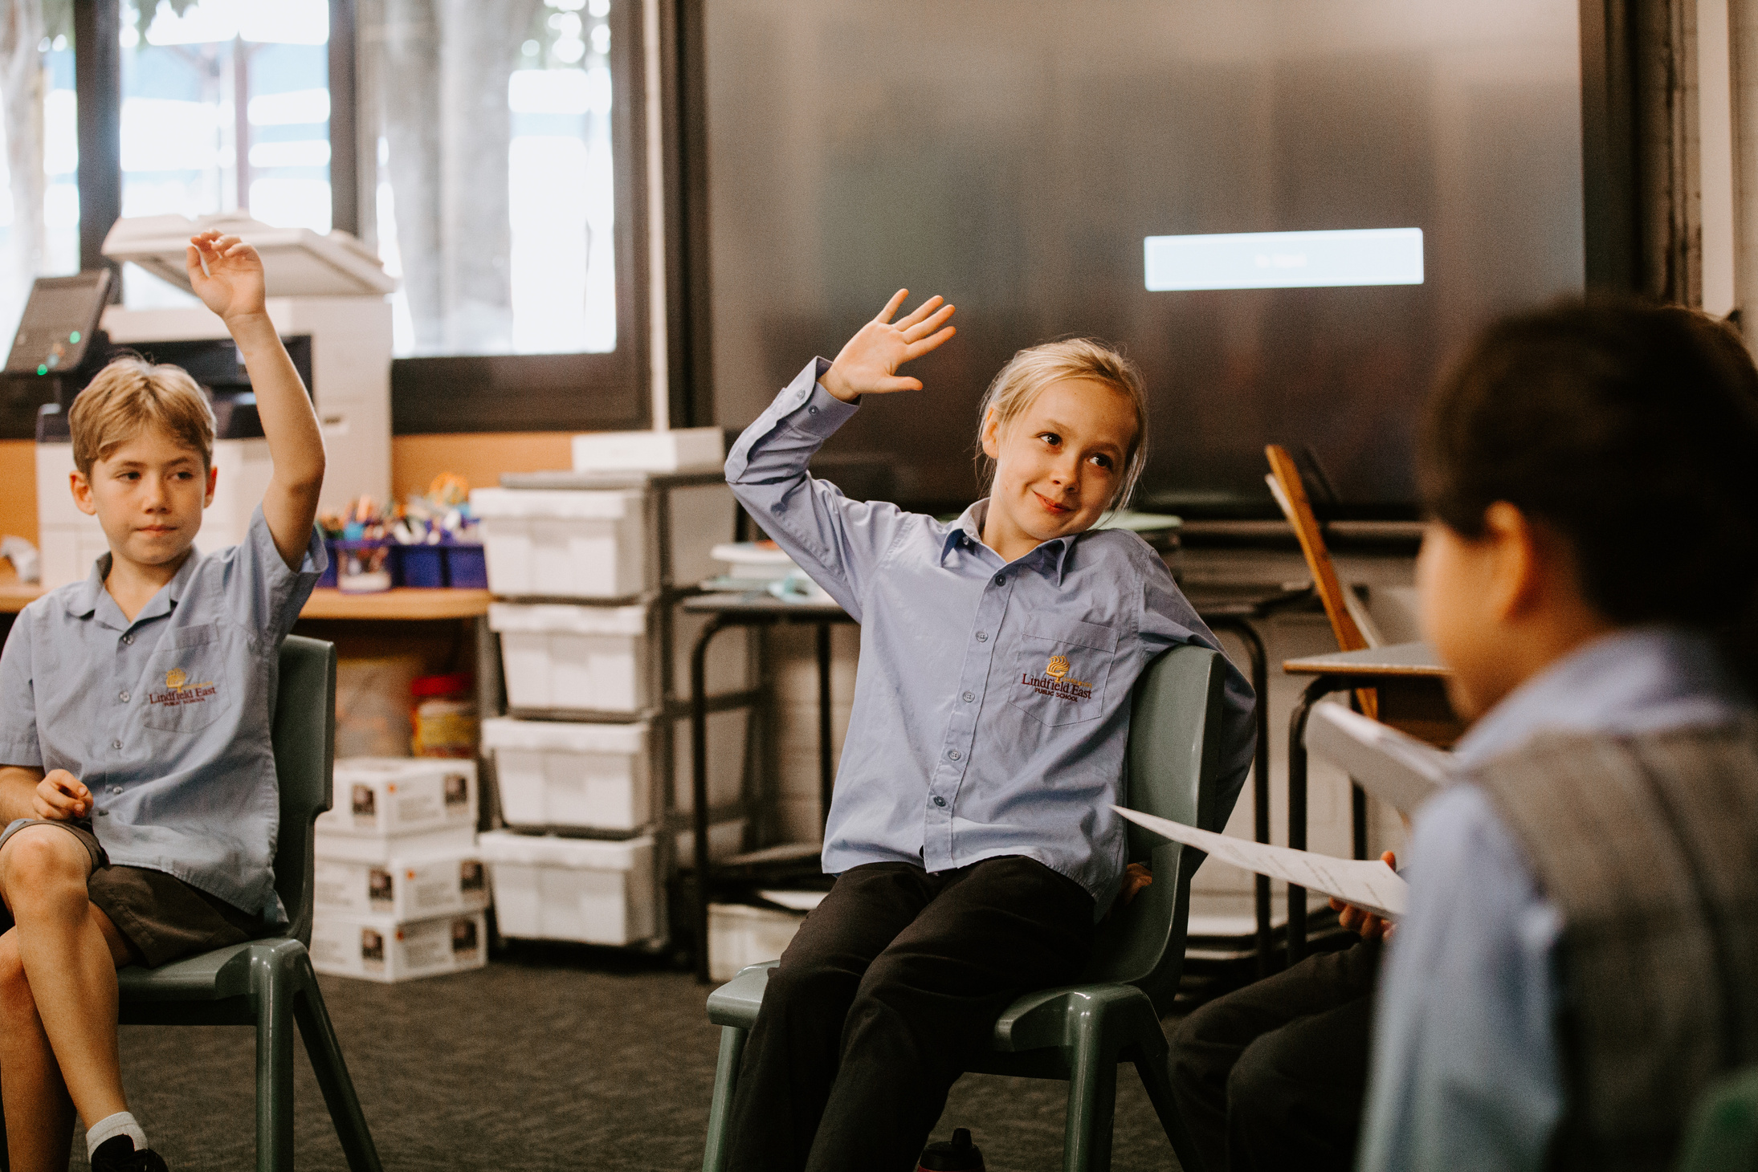

Slide 2
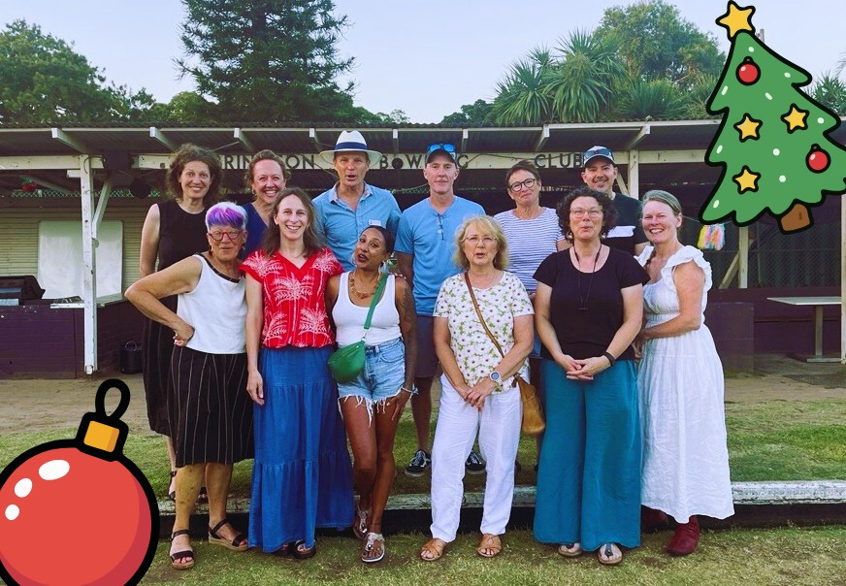
Who are we?
Not-for-profit in our 16th year of operations
Sole approved provider of ethics classes to NSW public schools
Presence in more than 460 schools
Supported by over 2000 trained volunteers
Reaching close to 40,000 children every week
Open to children and volunteers of all faiths — and none

Slide 3
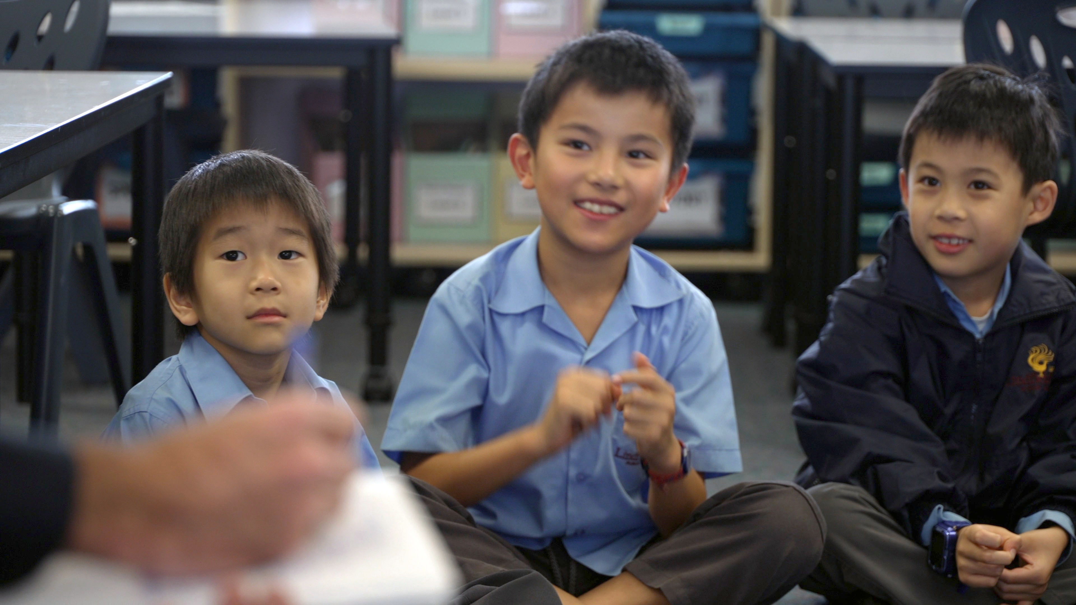
What do children gain?
In our safe, non-judgemental ethics classes, children learn to:
evaluate opinions and arguments
express disagreement respectfully
collaborate with others - even when they disagree
navigate complex situations with empathy and insight.
These skills have lasting benefits for their future roles — as colleagues, friends, family members and citizens.

Slide 4

What’s in our curriculum?
Our curriculum is:
Approved by the NSW Department of Education
Designed by philosophy and education experts
Over 100 topics and 270 lessons
Questions we talk about in lessons-
If you’re five, how would you react if someone called you a show-off?
If you’re nine and your friend doesn’t choose you to go to a movie on her birthday, would you stop being friends with her?
If you’re 12 and a chatbot told you it was feeling sad, would you believe it does have feelings? How could you tell?
If you’re 14, why aren’t you allowed to vote?

Slide 5
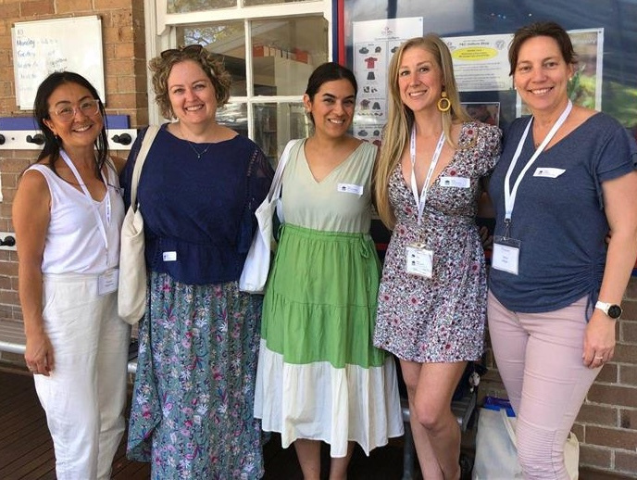
Why We Need You
Our program has grown thanks to dedicated parents and grandparents.
Now, we invite the wider community to be part of something meaningful.
By volunteering for just one hour a week, you can:
Support local children and be inspired by them
Strengthen your own connections to your local community
Help ensure no child is on a waiting list for an ethics class
Develop your own skills, eg how to disagree respectfully.
Add more text

Slide 6
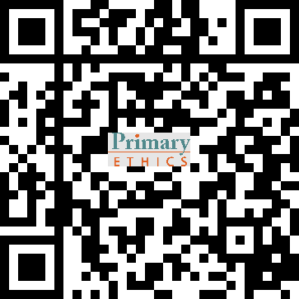
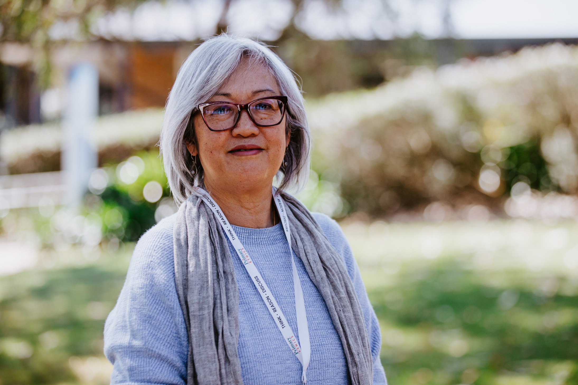
Volunteering is Easier Than You Think!
You don’t need teaching experience — just:
An interest in children’s ideas
An open and neutral mindset
A willingness to learn
We provide:
Free training (online or face-to-face)
Fully scripted lesson materials
Ongoing support
Join us in shaping thoughtful, respectful future citizens.
Visit: www.primaryethics.com.au/volunteer
Phone: 02 8068 7752
Email: [insert contact details]

